Slide 1
Dynamics F&O and Power Platform Integration Deep Dive

Slide 2

Nathan Clouse
Technical Architect enVista Corp.
Microsoft Business Applications MVP (3x)
nclouse@envistacorp.com
www.atomicax.com
www.dynamics.fo
@NathanClouseAX
Nathan Clouse
Technical Architect, Microsoft MVP
enVista Corp.

Slide 3

Sukrut Parab
Director of Development
Hitachi Solutions America Ltd
Microsoft Business Applications MVP (3x)
sparab@hitachisolutions.com
https://elearnd365.com/
@SukrutParab
Sukrut Parab
Director, Microsoft MVP
Hitachi Solutions.

Slide 4

Gift Card Giveaway
….. At the end

Slide 5
What is the Power Platform Integration?
Environments
Dual Write
Virtual Entities
Authentication & Authorization
F&O Business Events in Dataverse
F&O CUD Events in Dataverse
LCS Add-Ins and Power Platform Add-ons

Slide 6
Power platform integration
Create apps and flows in the automatically created environment
Integrate finance and operations apps data with the Dataverse platform by using virtual tables, business events, and dual-write features.
Install and connect other Dynamics 365 applications with your finance and operations apps.
Install add-ins and connect them with your finance and operations apps.

Slide 7
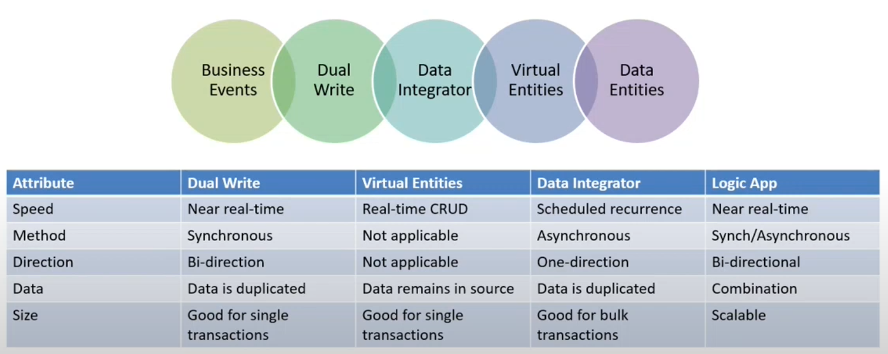
Power platform integration
Notes:
Credit: Rachel Profit

Slide 8
Environments
By Default, F&O environments (Sandbox and Production) has power platform environment
Environment is linked to F&O
Deployment can be done through LCS
Three available templates when you deploy enviornment from LCS (Dynamics 365 Standard, Dynamics 365 Standard with dual-write, Project operations)
Existing dataverse enviornment can be linked to new F&O enviornment.

Slide 9
Platform Convergence
Everything we’re talking about right now
Use Power Platform tools with your F&O data
Bringing together the Power Platform plus F&O into a unified experience in Power Platform Admin Center (PPAC)
Dataverse is included with F&O – 10 GBs of capacity

Slide 10
Templates
Dynamics 365 Standard
This basic template prepares all the platform components for business events, virtual tables, dual-write functionality, and add-in support. Dual-write isn't enabled and won't automatically sync data when this template is selected. Select this template if you don't require a more specific template.
The ¯\_( ͡• ͜ʖ ͡•)_/¯ Option
Includes these D365 Apps: MicrosoftOperationsVEAnchor, DualWriteCoreAnchor, MsDynCE_CRMHub, MsDyn_FnOIntegrationMDLApp_Anchor

Slide 11
Templates
Dynamics 365 Standard with dual-write
This template is the same as Dynamics 365 Standard, but it includes all the applications that are required for dual-write, so that you can quickly enable that feature after environment deployment.
The ( ͡• ͜ʖ ͡•) option
Includes these D365 apps: MicrosoftOperationsVEAnchor, DualWriteCoreAnchor, MsDynCE_CRMHub, MsDyn_FnOIntegrationMDLApp_Anchor, MsDyn_DualWriteAppCoreAnchor

Slide 12
Templates
Project Operations
This template is specific to the Dynamics 365 Project Operations scenario. It's available only if your tenant has licenses and entitlement for Project Operations.
The (ง︡'-'︠)ง option
Includes these D365 Apps: MicrosoftOperationsVEAnchor, Dynamics365FinanceAndOperationsAnchor, ProjectOperations_Anchor

Slide 13
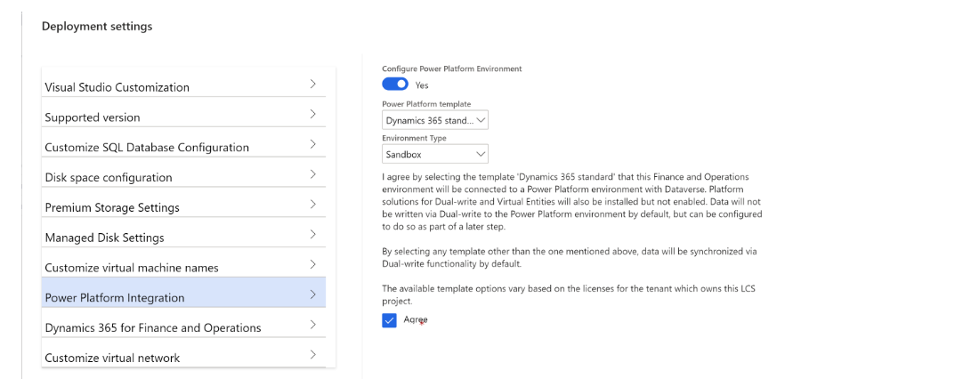
Environments
Enable integration during deployment
Notes:
Deploying dataverse enviornment connected to F&O while deploying sandbox or tier 1 VM

Slide 14
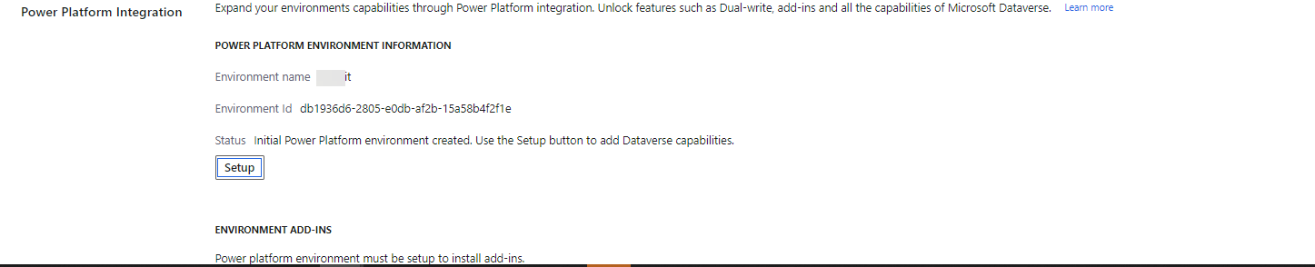
Environments
Enable integration after enviornment deployment
Notes:
Connecting existing dataverse enviornment to new F&O enviornment.

Slide 15
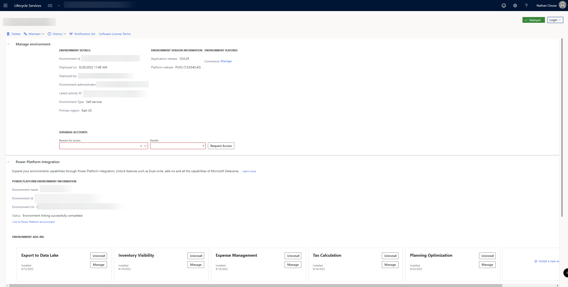

Slide 17
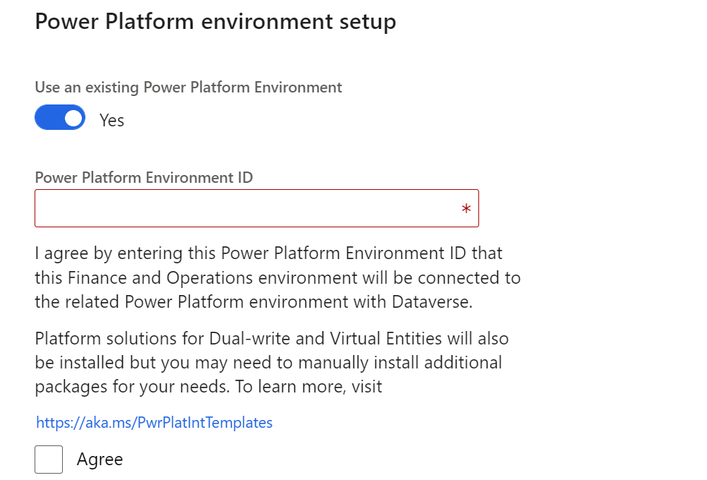
Environments
Enable integration after enviornment deployment
Notes:
Power platform enviornment ID can be obtained from PPAC.

Slide 18

Validations
Enable D365 apps option must be enabled when Dataverse is deployed in the Power Platform environment
The Power Platform environment must be in the same geography as finance and operations apps. For example, better to have both environments in the east US or west US 2
The user in LCS who is doing the Power Platform integration setup must be an administrator of the environment in Dataverse and License assigned in F&O
Notes:
Validations must be passed to connect existing dataverse enviornment.

Slide 19
Enable integration in cloud hosted VM
Requires AAD app (client ID and secrete)
Grant permission to app in F&O from System administration > Setup > Azure Active Directory applications.
Dataverse enviornment URL which you want to link
Run PowerShell script provided in the docs article
https://learn.microsoft.com/en-us/dynamics365/fin-ops-core/dev-itpro/power-platform/enable-power-platform-integration#enable-the-integration-for-cloud-hosted-development-environments

Slide 20
Dual-Write
Dual-write is an out-of-box infrastructure that provides near-real-time interaction between customer engagement apps and finance and operations apps.
Supported data entities are can “primaried” in 2 different systems at the same time
Synchronous and bidirectional data flow between applications
Synchronization, together with play, pause, and catchup modes to support the system during online and offline/asynchronous modes.
Ability to sync initial data between the applications
Out-of-box setup experience for new customers

Slide 21
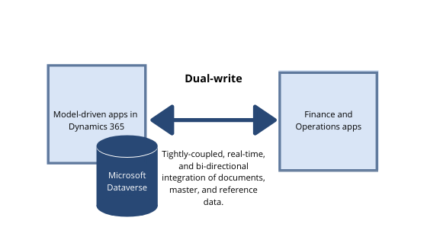
Dual-Write

Slide 22
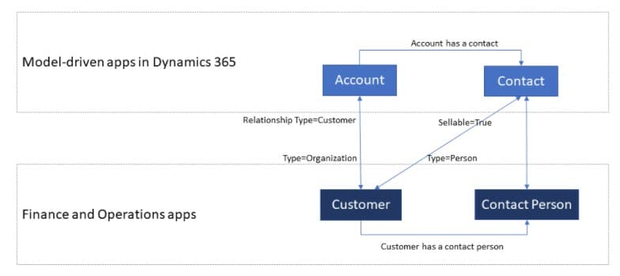
Dual-Write

Slide 23
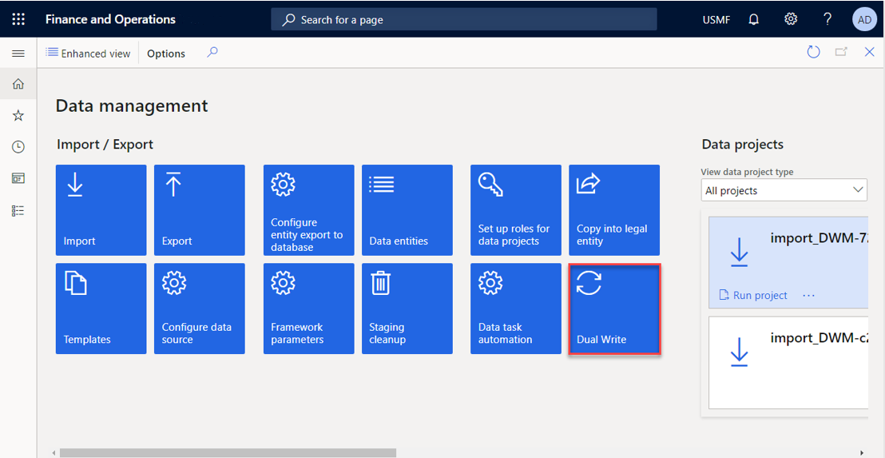
Old

Slide 24
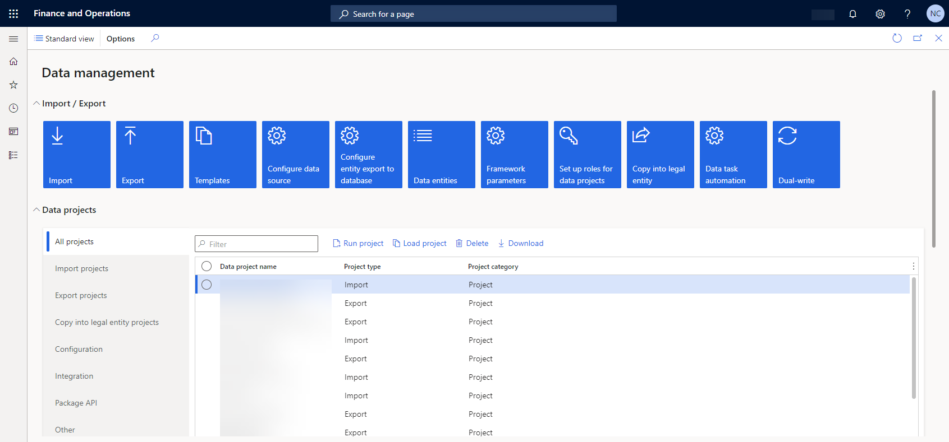
New

Slide 25
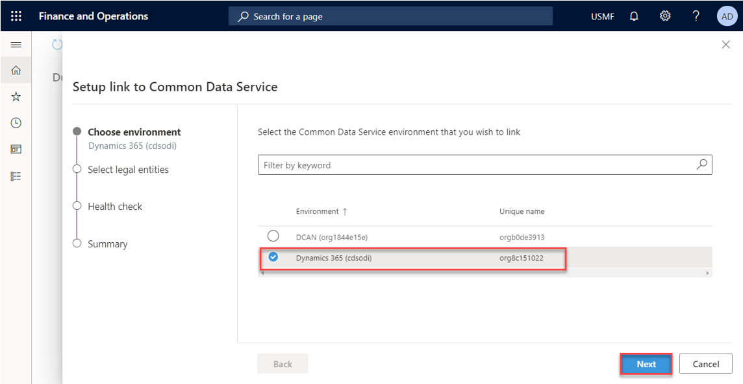

Slide 26
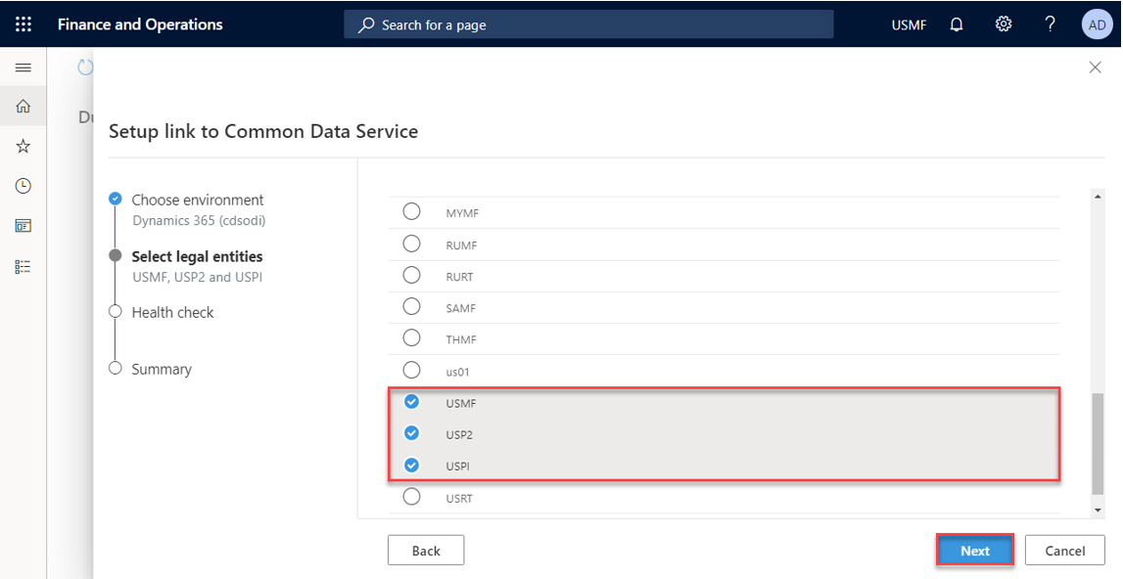

Slide 27
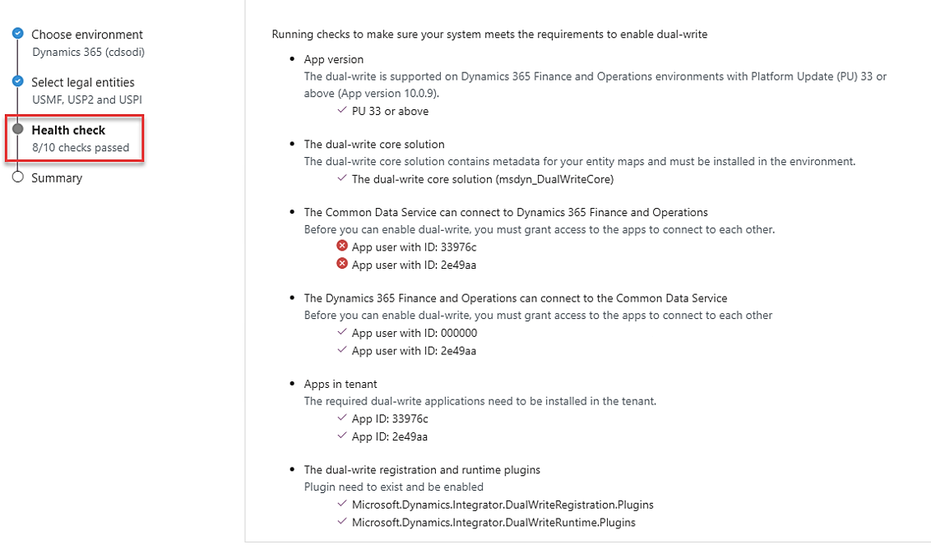

Slide 28
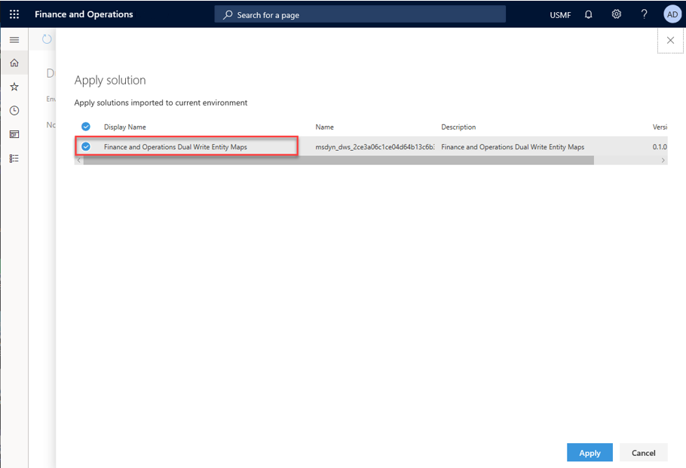

Slide 29
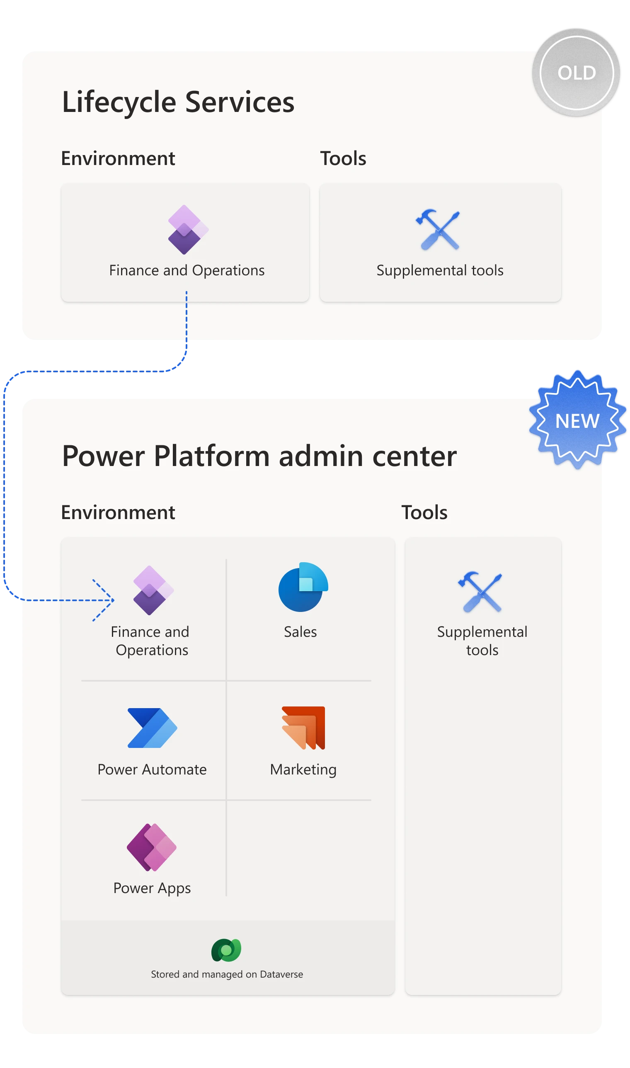

Slide 30


Slide 31


Slide 33
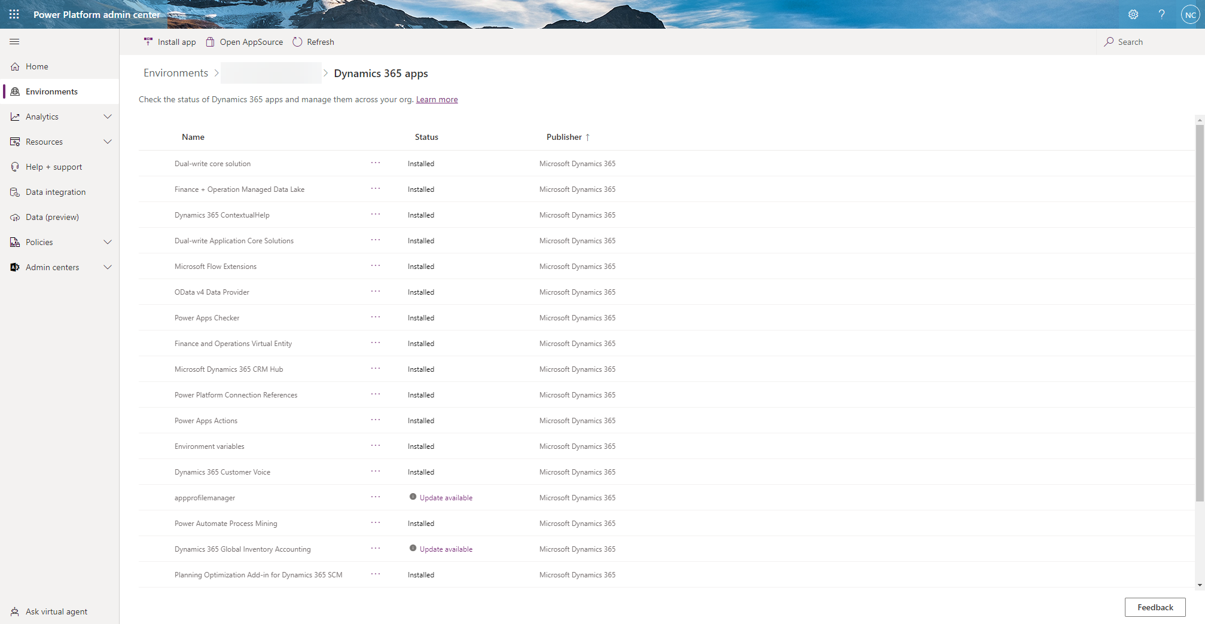
Notes:
Extend F&O plus d365 with new apps from PPAC

Slide 34
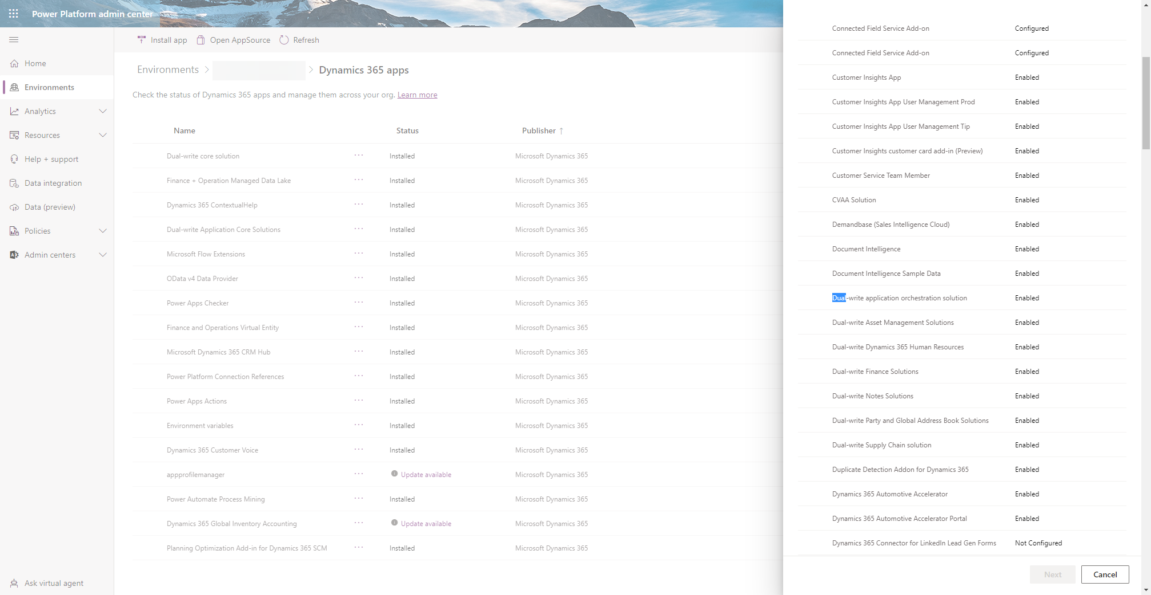

Slide 35
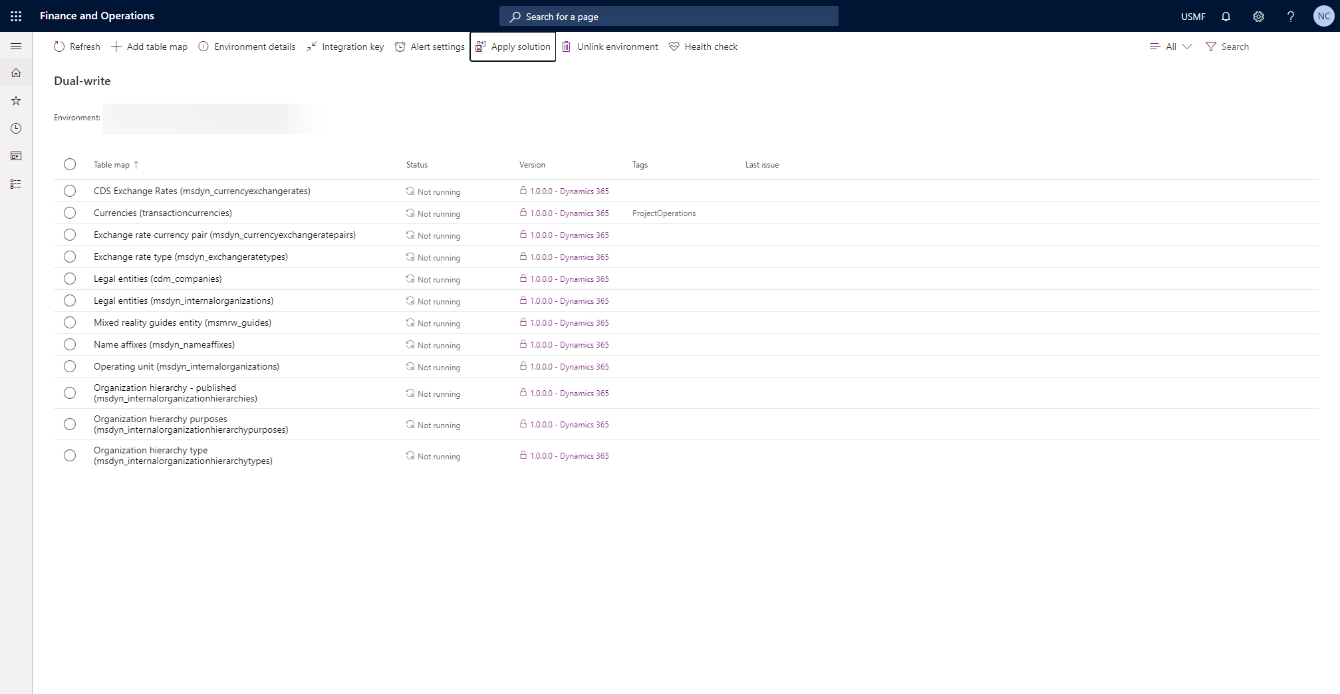

Slide 36
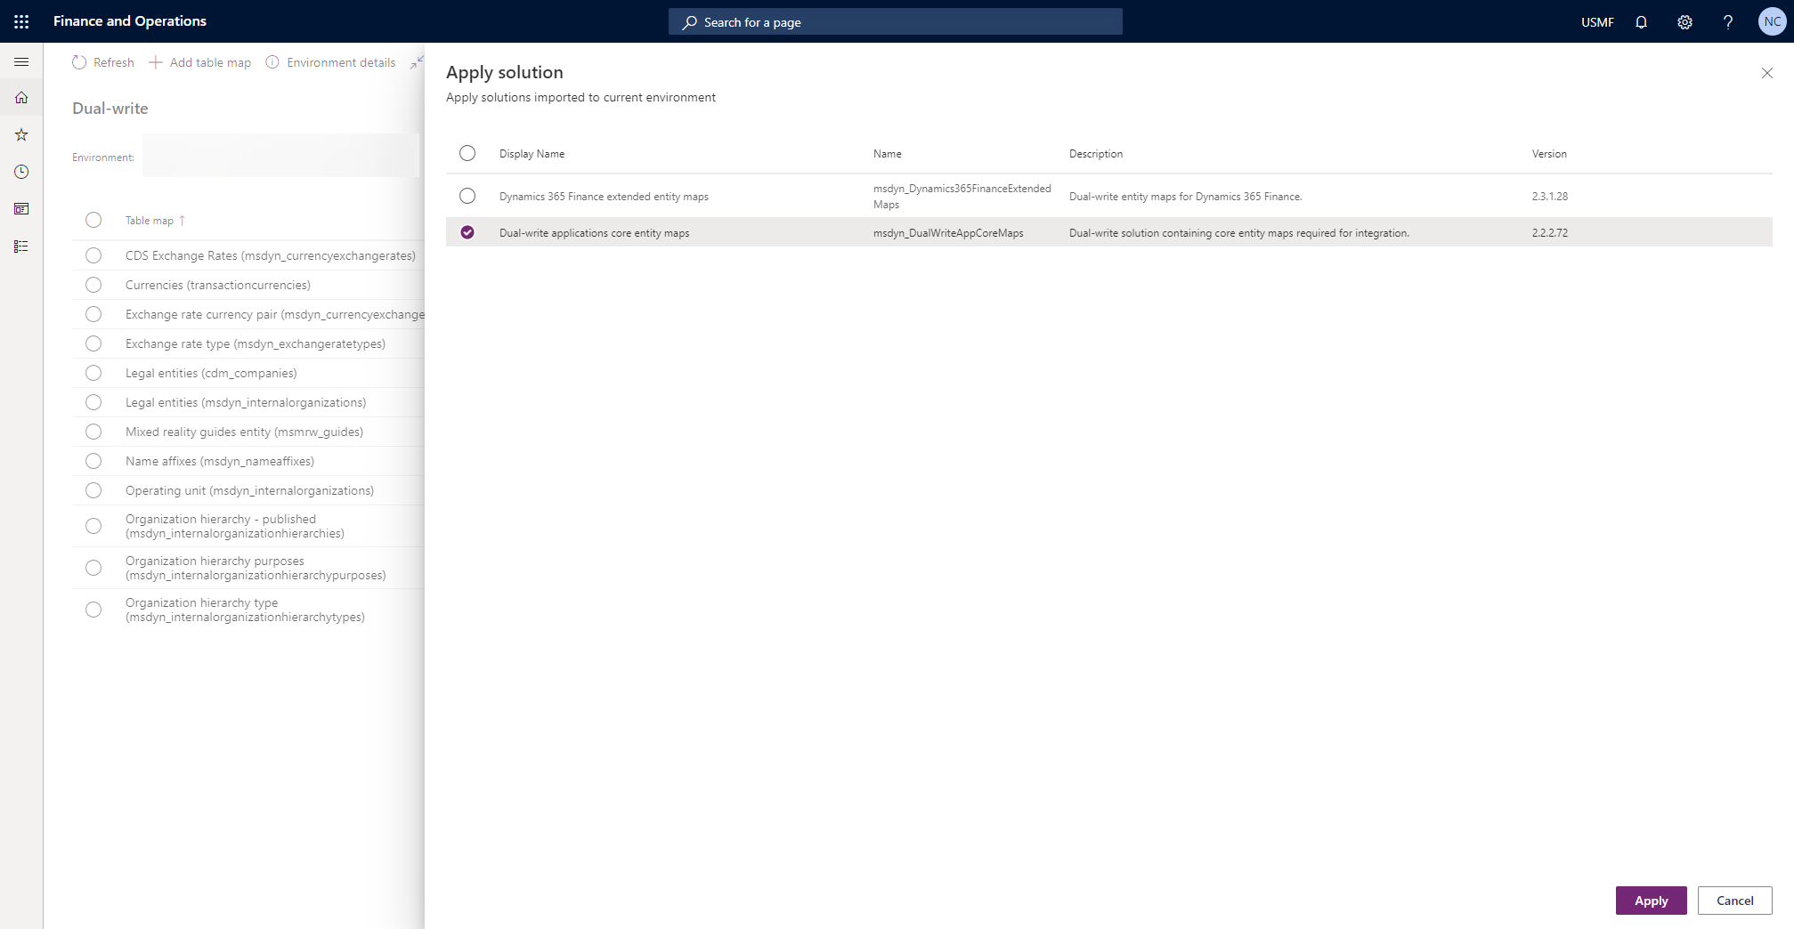

Slide 37
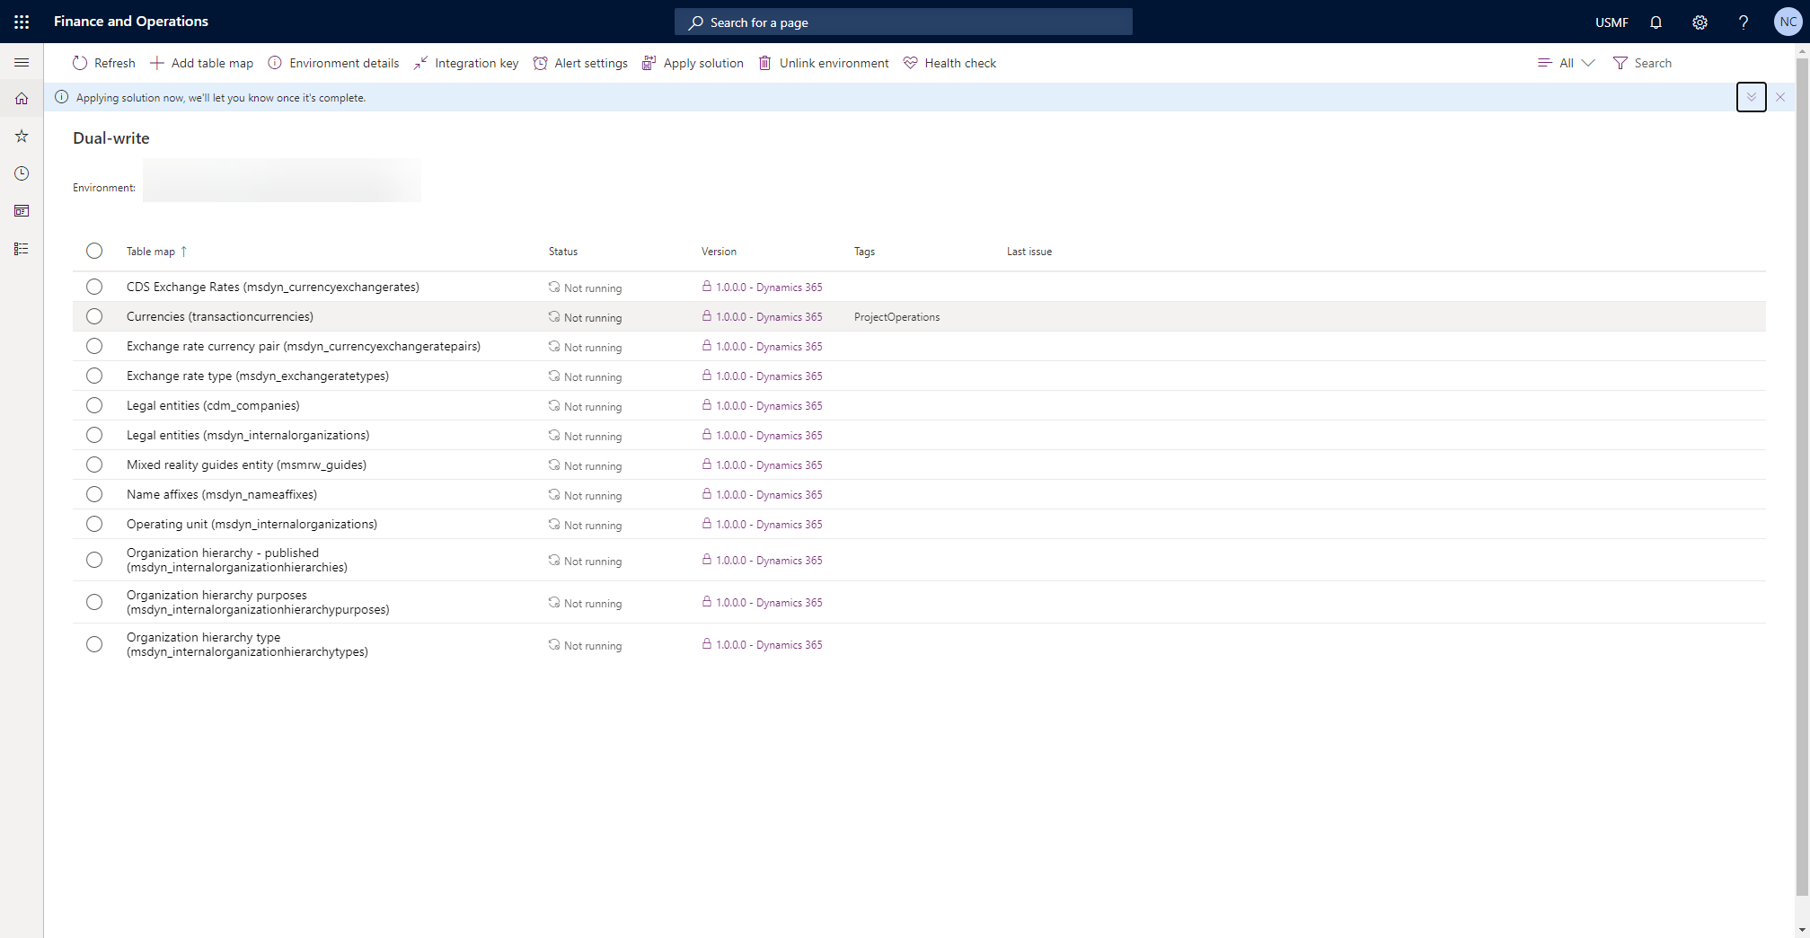

Slide 38
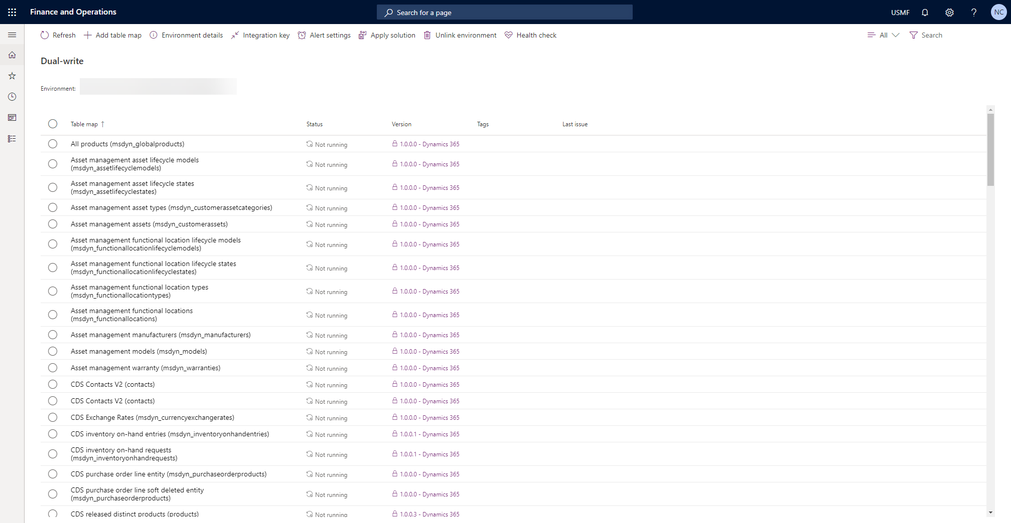

Slide 39
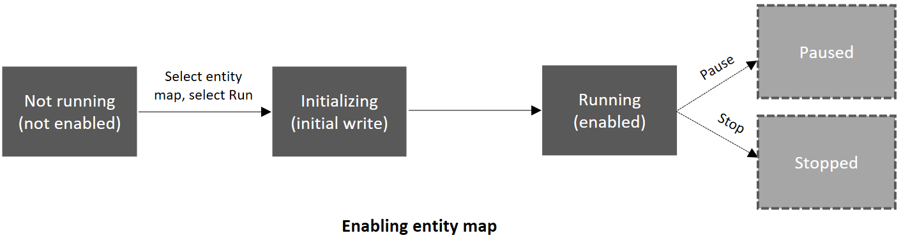
Enabling Entities
List
Initialize
Running
Paused or Stopped

Slide 40
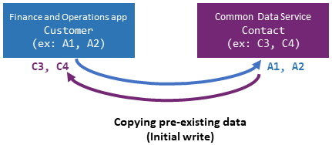
Initialization
Copy F&O to/from Dataverse
You pick which system is the primary for sync purposes

Slide 41
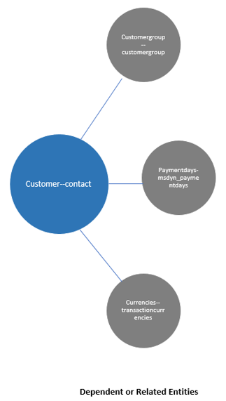
Dependencies
Some data entities rely on other entities
For instance…
Customer – Contact relies on
Customer Group
Payment Days
Transaction Currency
Option to sync all related data entities when selecting what to enable for dual-write

Slide 42
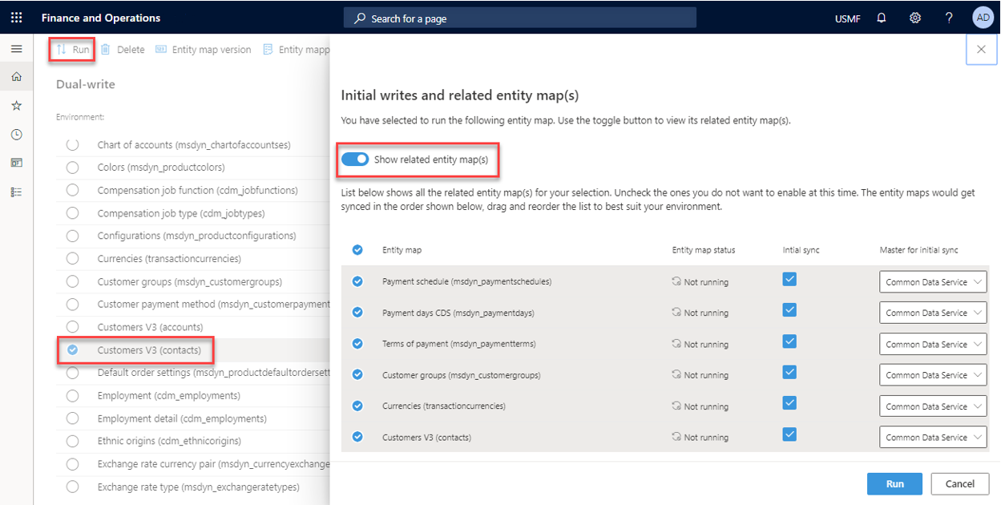

Slide 43
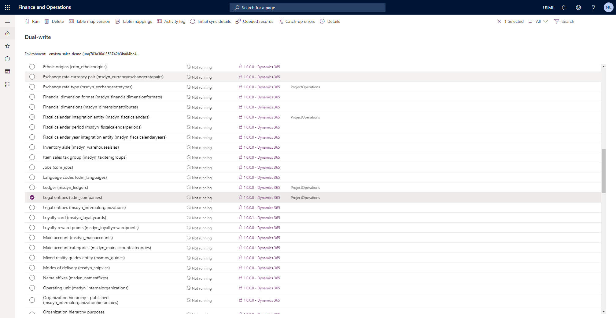
Notes:
Call out entity name differences

Slide 44
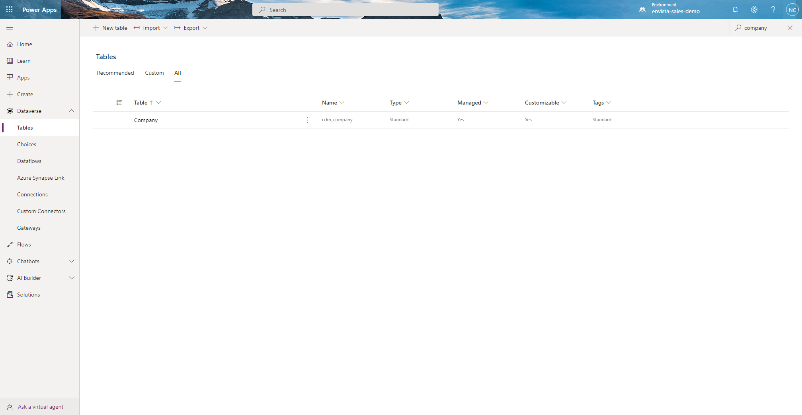

Slide 45
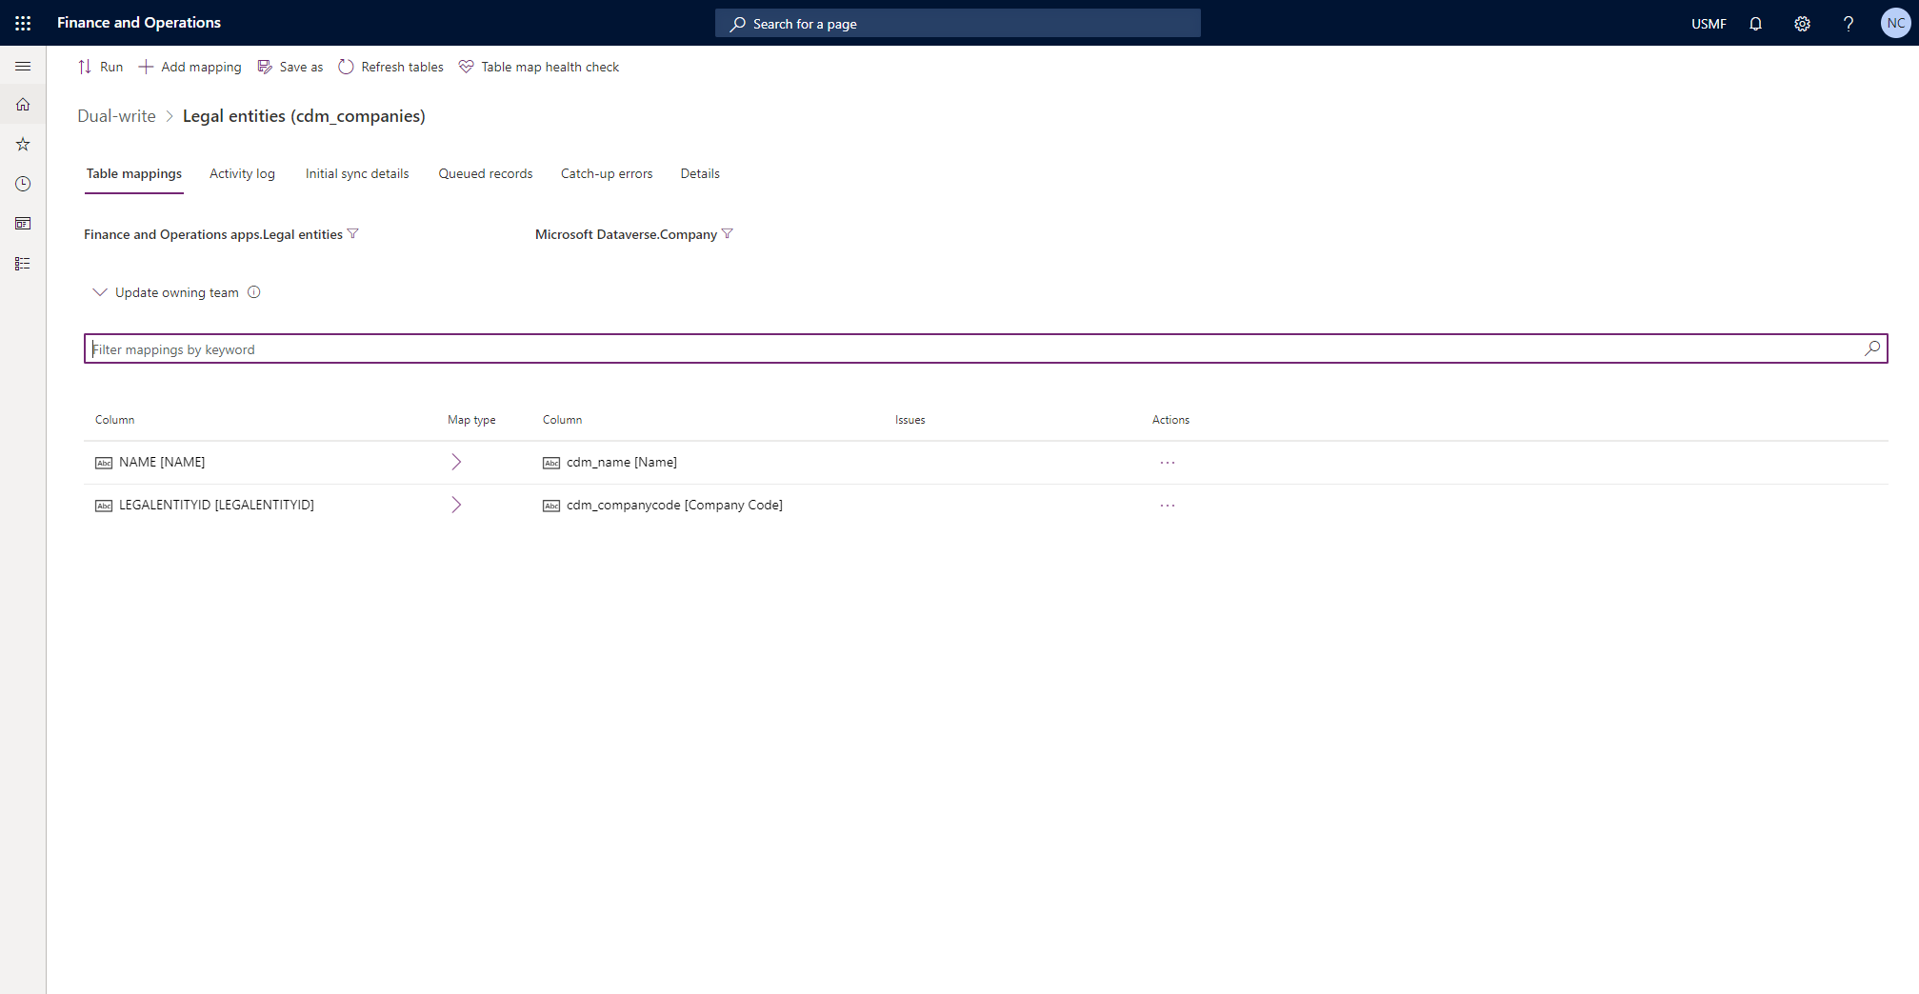

Slide 46

Virtual Entities
Virtual entities are installed in the environment with the Microsoft Power Platform integration. It will no longer be required to set up manual connections between the environments as the environments are preconnected.
Notes:
Talk about capabilities provided by PPAC for d365 apps and future of PPAC to manage f&O environments

Slide 47
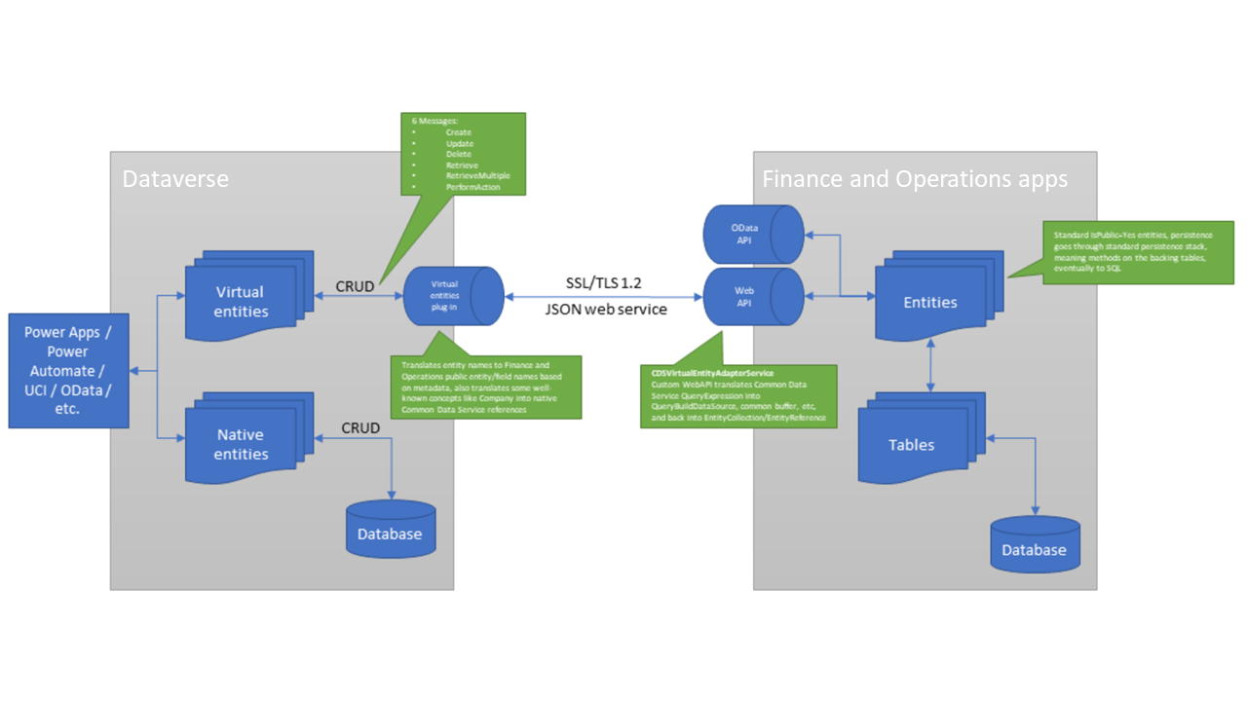

Slide 48
Virtual Entities
Data type in finance and operations | Modeled data type in Dataverse
Real | Decimal
Long | Decimal, where the precision equals 0 (zero)
Int | Integer
String (non-memo), String (memo) | String – single line of text, String – multiple lines of text
UtcDateTime | DateTime (DateTimeFormat.DateAndTime, DateTimeBehavior.TimeZoneIndependent) An empty date (January 1, 1900) in finance and operations is surfaced as a null value in Dataverse.
Notes:
Talk about capabilities provided by PPAC for d365 apps and future of PPAC to manage f&O environments

Slide 49
Virtual Entities
Date | DateTime - (DateTimeFormat.DateOnly, DateTimeBehavior.TimeZoneIndependent) An empty date (January 1, 1900) in finance and operations is surfaced as an empty value in Dataverse.
Enum | Picklist Finance and operations enumerations (enums) are generated as global OptionSets in Dataverse. Matching between the systems is done by using the External Name property of values. Enum integer values in Dataverse aren't guaranteed to be stable between the systems. Therefore, you should not rely on them, especially in the case of extensible enums, because these enums don't have a stable ID either. OptionSet metadata is updated when an entity that uses the OptionSet is updated.
Notes:
Talk about capabilities provided by PPAC for d365 apps and future of PPAC to manage f&O environments

Slide 50
Enviornment lifecycle considerations
F&O environments have one to one relationship with power platform environment.
In (distant?) Future all environments can be managed from PPAC.
LCS will be sunset in the next 5 years
(probably)
Notes:
Each F&O environment gets one power platform enviornment without dataverse.

Slide 51
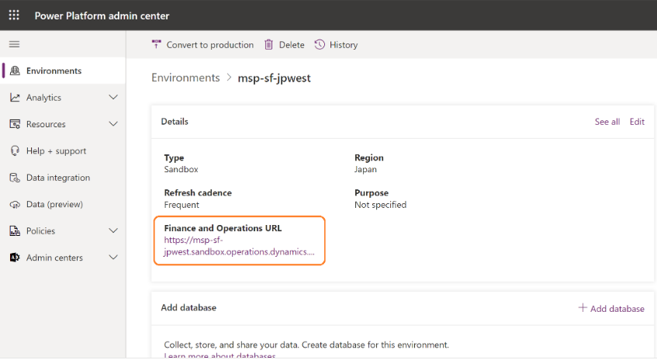
Enviornment lifecycle considerations
Example of F&O enviornment in PPAC
Notes:
Each F&O environment gets one power platform enviornment without dataverse.

Slide 52
Authentication and Authorization
Starting in a preview with version 10.0.20, and generally available with version 10.0.22, Finance and Operations users who use virtual entities will no longer be required to be manually added or managed in Dataverse. When Microsoft Power Platform integration is enabled, Finance and Operations users will be automatically added to Dataverse just in time when users access virtual entities from Power Apps. This functionality can be used by enabling flight BusinessEventsCDSIntegration in Finance and Operations apps.

Slide 53
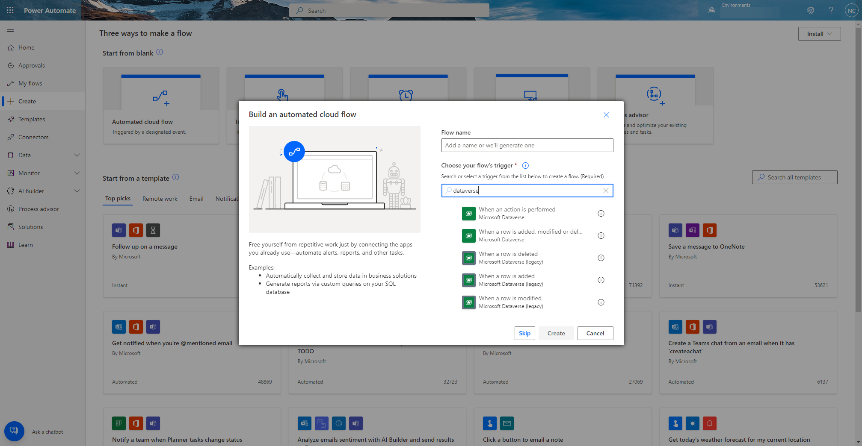
Data Events in Dataverse

Slide 54
What is a data event?
Any Create (C), Update (U), or Delete (D) on a data entity they has OData enabled
Ie; if the Create event is enabled on PO Headers V2, an event notification is emitted every time that a new purchase order is created in the database
Notice…..
Data Entity, not table – plan ahead
Notification is emitted
Can only use Data events in environments where the Power Platform is enabled (using LCS)

Slide 55
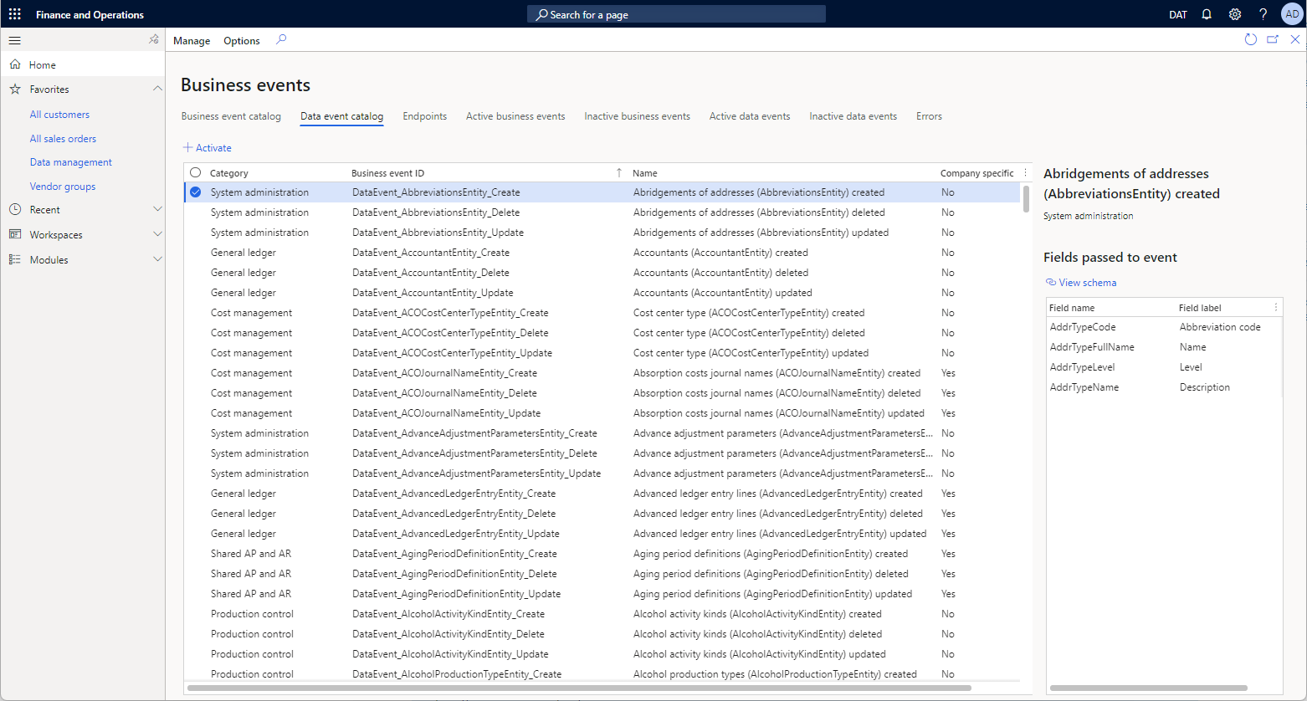
Catalog and what’s included
All Standard entities with OData enabled
Plus, all custom entities with OData enabled

Slide 56
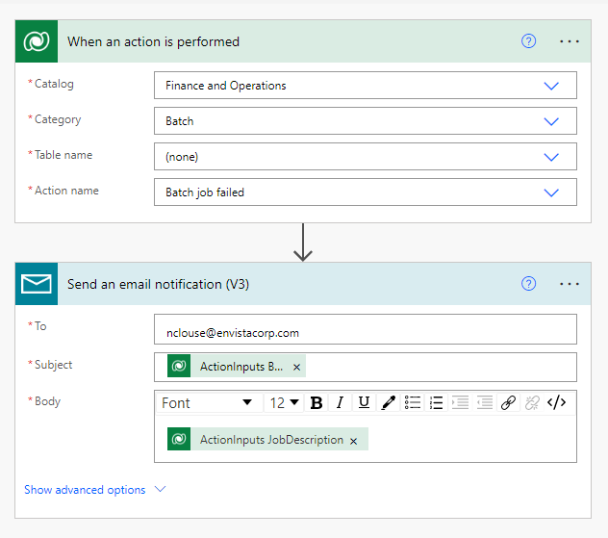
Business Events
Also available as “actions” in Dataverse
Similar to Data Events in Dataverse

Slide 58
How is it different than a business event?
Business Event
Data Event
Emits notification on process completion
Only available on processes
Small, lightweight message
(generally) high performance
Activated in 1 legal entity or all legal entities
Emits notification when a record operation completes
Only available on record operations
All fields in data entity? Yes*
Could have performance issues if overused
Activated in 1 legal entity or all legal entities

Slide 59
LCS Add-Ins and Power Platform Add-ons
Enable new features, functionality, “experiences”
Some come at no cost and some are at low cost (consumption)
Some add ins will be replacing or augmenting some functionality in the future

Slide 60
What Add-Ins are Available?
Power Platform Integration
Export to Data Lake
Planning Optimization
Tax Calculation Service
Finance Insights
Expense Management
Electronic Invoicing
Inventory Visibility
IoT Intelligence Sensor Data Intelligence
(Preview) Inventory Global Accounting

Slide 61
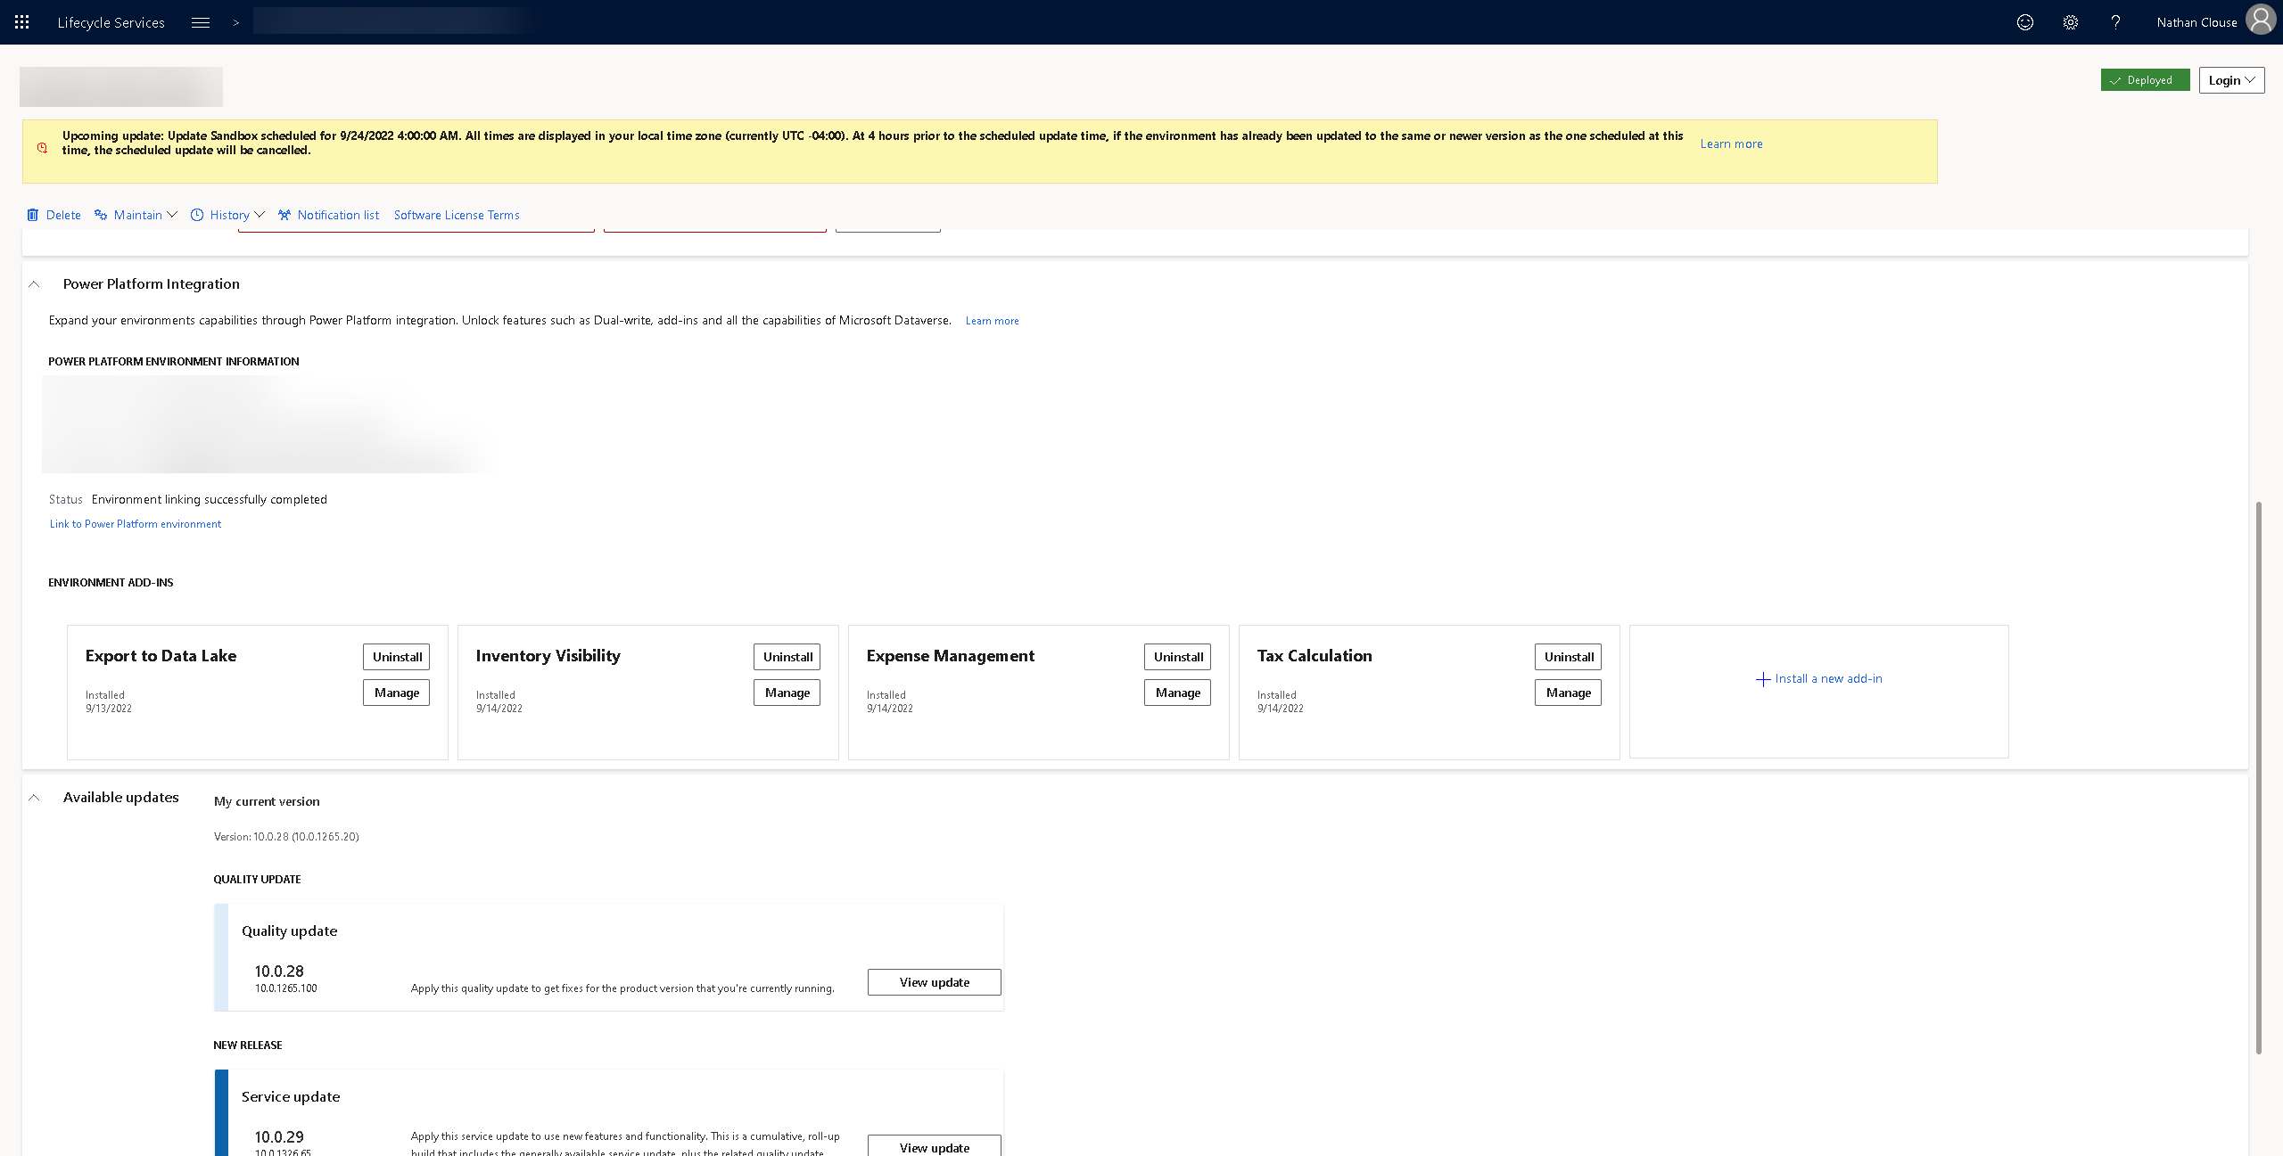
LCS Add-ins

Slide 63
LCS Add-ins

Slide 64
References
https://learn.microsoft.com/en-us/dynamics365/fin-ops-core/dev-itpro/data-entities/dual-write/dual-write-home-page
https://learn.microsoft.com/en-us/dynamics365/fin-ops-core/dev-itpro/power-platform/enable-power-platform-integration
https://learn.microsoft.com/en-us/dynamics365/fin-ops-core/dev-itpro/power-platform/virtual-entities-overview
https://learn.microsoft.com/en-us/dynamics365/fin-ops-core/dev-itpro/business-events/home-page
https://learn.microsoft.com/en-us/dynamics365/fin-ops-core/dev-itpro/power-platform/add-ins-overview

Slide 66
Give Away
Also, all of my PowerPoints will be available for download at https://github.com/NathanClouseAX/CommunityPresentations/tree/master/2022 by end of the week

Slide 67


